Slide 1

SMART INDIA HACKATHON 2026
Problem Statement ID – 26132
Problem Statement Title- Strengthening market linkages and price discovery for farmers
Theme- Agriculture, FoodTech & Rural Development
PS Category- Software
Team ID-
Team Name- KS-SAND

Slide 2
Krishi-Setu
KS-SAND
Farmers/FPO
Double Auction Engine
Buyers
Verified Quality,
Matches &
Bids, volume
asks
Multi Channel Access
App, Kiosk,
SMS
needs
Pools Trades
Detailed Explanation
How We Address the Problem
Innovation and Uniqueness
Access List
Verify Quality
Submit Ask/Bid
Batch Auction Matches
Pooling
Settle Payment
Kiosk System for better reach
AI Grading along with official certificate check
Farmer Sets Asks, Buyer Sets Bid
Runs at fixed intervals
Combines Consenting Farmers
Traceable per-farmer payout
Platform
Pledge Loans for Liquidity
Double Auction for fairness
Price Visibility through aggregated market data
Better reach through kiosks
Quality trust, AI certified grading
Buyer Volume with Pooling
Two-Sided Auction Farmers & buyers both set price
Price Forecasting Sell-now or hold guidance
Cross-Farmer Pooling Traceable, quality kept separate
AI Quality Grading Instant photo-based grade estimate
In-App Liquidity MSAMB pledge loan and Anchor Buyers
Kiosk + SMS Access No farmer left offline

Slide 3
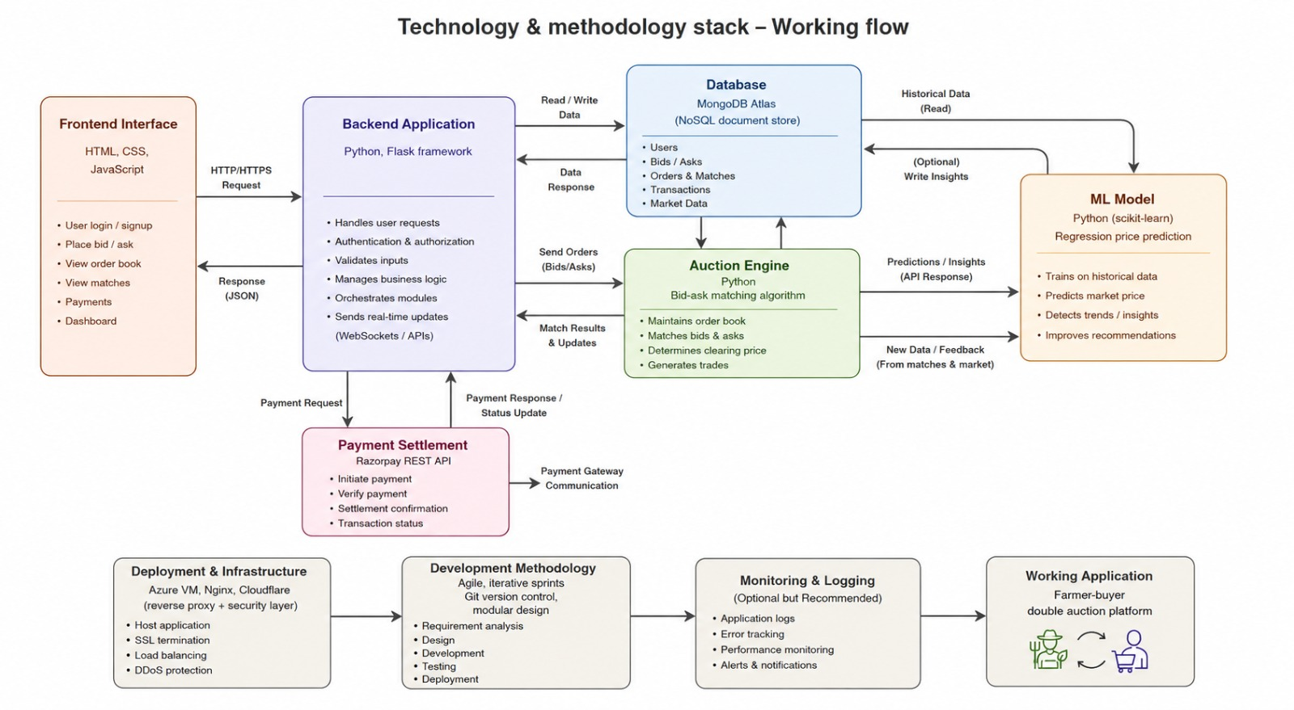
TECHNICAL APPROACH
KS-SAND

Slide 4
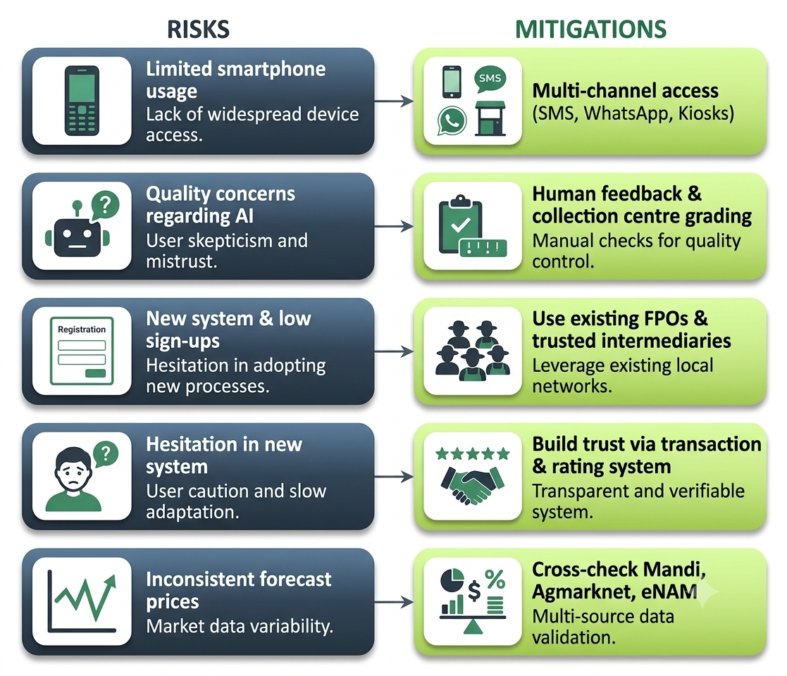
FEASIBILITY AND VIABILITY
KS-SAND
FEASIBILITY
Price Discovery and aggregation.
Existing feeds (eNAM, Agmarknet); no new infra needed
Price Forecast System
Pre-built lightweight model; fast, low-cost to train
Price Pooling
Warehouse & Silo Finder
Simple model farmers; already pool informally
Location of warehouse data; commonly used
AI Grading System
Open Source Models with custom trained data; Cuts Load
Anchor Buyers and Pledge Loans
24/7 demand and loans with crops as collateral; Solves Liquidity

Slide 5
IMPACT AND BENEFITS
KS-SAND
Farmers After
Steady Income, Higher Visibility, Less Spoilage
Farmers Before
Low Visibility, Low Power
Our System
Personalized Matching + Real Time Prices
Buyers Before
Hard to Source, Quality Verification
Buyers After
Quality Assurance, Pooled Supply
Social
Trust and Transparency between buyers and farmers
Economic
Fair Prices and Efficient Sourcing
Environmental
Less Waste due to lower post harvest sale
Government
Better Market visibility and digital records and silo utilization

Slide 6
RESEARCH AND REFERENCES
KS-SAND
Arrival Price info: https://www.msamb.com/ApmcDetail/APMCPriceInformation
Market Network:
https://www.msamb.com/Projects/MarketNetwork
National Agriculture Market:
https://enam.gov.in/
DataSets (general and specialized):
https://www.data.gov.in/
AgMarkNet:
https://agmarknet.gov.in/home

Slide 7
IMPORTANT INSTRUCTIONS
Please ensure below pointers are met while submitting the Idea PPT:
Kindly keep the maximum slides limit up to six (6). ( Including the title slide)
Try to avoid paragraphs and post your idea in points /diagrams / Infographics /pictures
Keep your explanation precise and easy to understand
Idea should be unique and novel.
You can only use provided template for making the PPT without changing the idea details pointers (mentioned in previous slides).
You need to save the file in PDF and upload the same on portal. No PPT, Word Doc or any other format will be supported.
Note - You can delete this slide (Important Pointers) when you upload the details of your idea on SIH portal.

